Slide 1

Prediction of Heart Disease using Machine Learning Techniques
CIS 490 Machine Learning MT Project Presentation
Kevin D’Cruz (L)
Chetan Kumar
Abhishek Manoj Kumar
Madhuri Gawali
Apoorva ShivaShankar

Slide 2
Outline
Machine Learning Models
Logistic Regression
Decision Trees
Neural Network
Datasets – Heart Disease Dataset from UCI Irvine ML Repository
Cleveland
Statlog
SPECT
Results
Comparison / Related Work
Future Work

Slide 3
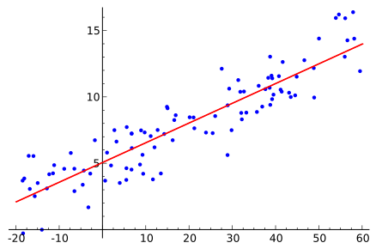
Logistic Regression
It’s a statistical method for analyzing a dataset having one or more independent variables to determine an outcome.
Outcome is measured with a dichotomous variable (two possible outcomes)
Having True (1) and False (0)
Logistic Regression is to find the best fit model to describe the relationship between the dependent variable and set of independent variables.

Slide 4
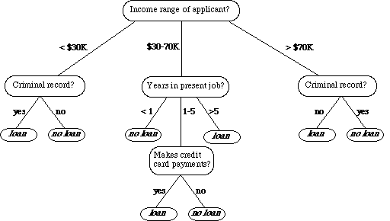
Decision Trees
Its type of supervised learning
Works for both categorical and continuous input and output variables.
Split the population or sample into two or more homogeneous sets (or sub-populations) based on most significant splitter / differentiator in input variables.
Split the population or sample into two or more homogeneous sets (or sub-populations) based on most significant splitter / differentiator in input variables.
If there is a high non-linearity & complex relationship between dependent & independent variables, a tree model will outperform a classical regression method.
If you need to build a model which is easy to explain to people, a decision tree model will always do better than a linear model. Decision tree models are even simpler to interpret than linear regression!

Slide 5
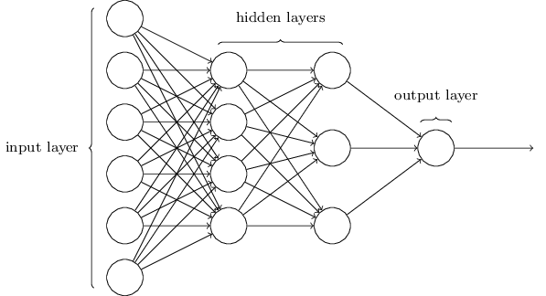
Neural Network
An Artificial Neural Network (ANN) is an information processing paradigm that is inspired by the way biological nervous systems, such as the brain, process information.
It is composed of a large number of highly interconnected processing elements (neurones) working in unison to solve specific problems.
Why Neural Network
Adaptive learning: An ability to learn how to do tasks based on the data given for training or initial experience.
Self-Organisation: An ANN can create its own organisation or representation of the information it receives during learning time.
Real Time Operation: ANN computations may be carried out in parallel, and special hardware devices are being designed and manufactured which take advantage of this capability.

Slide 6
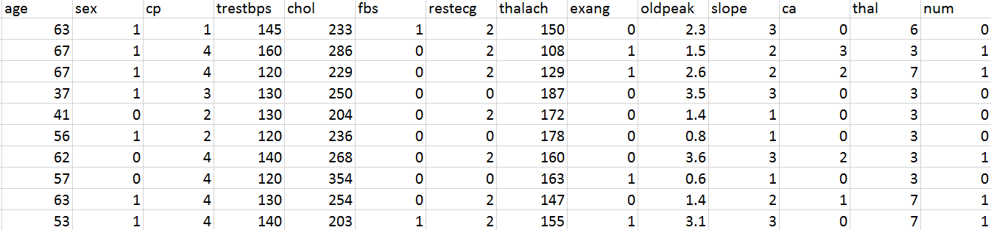
Cleveland Heart Disease Dataset
Attributes → 14
Instances →304
Prediction Variable → num
0: Absence | 1: Present
164 | 139

Slide 7
Cleveland Heart Disease Dataset Preprocess
Labeled each column with the names provided
Missing Values
Attributes: ca and thal
Used Linear Regression to predict missing values
Prediction Variable : num
Presence: 1,2,3,4 is assigned 1
Absence: 0

Slide 8
Cleveland Heart Disease Dataset Results
Train Data
Algorithm | Accuracy | Misclassification Error | Sensitivity | Specificity
Logistic Regression | 83.17757009 | 16.82242991 | 81.37254901 | 84.82142857
Decision Trees | 78.5046729 | 21.4953271 | 93.75 | 61.764705
Neural Network | 52.3364486 | 47.6635514
Test Data
Algorithm | Accuracy | Misclassification Error | Sensitivity | Specificity
Logistic Regression | 88.76404494 | 11.23595506 | 81.081081 | 94.230769
Decision Trees | 75.28089888 | 24.71910112 | 94.230769 | 48.64864
Neural Network | 58.42696629 | 41.57303371

Slide 9
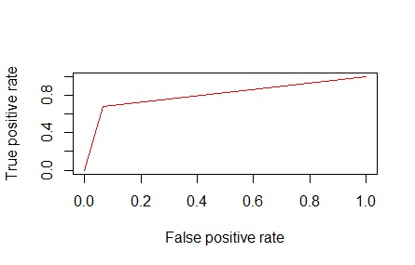
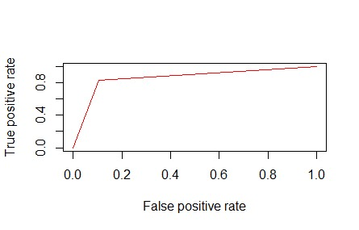
ROC – Logistic Regression
Train Data
Test Data

Slide 10
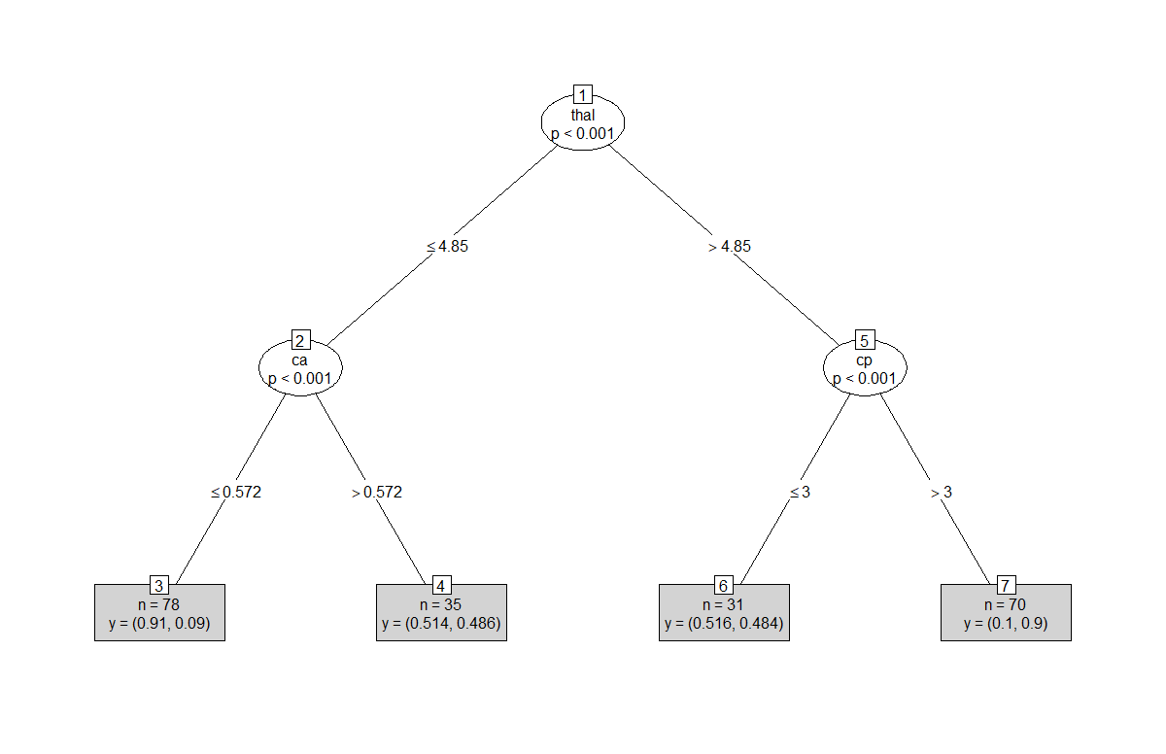
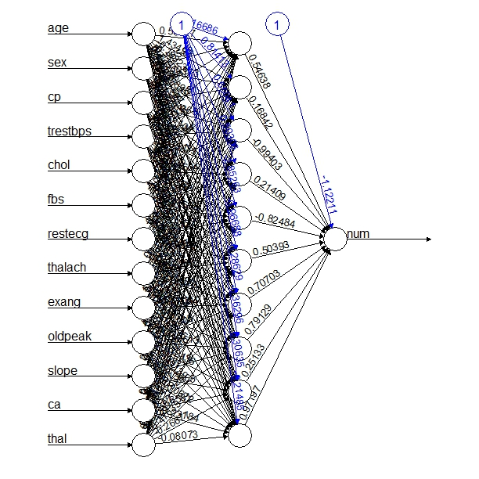
Decision Tree
Neural Network

Slide 11
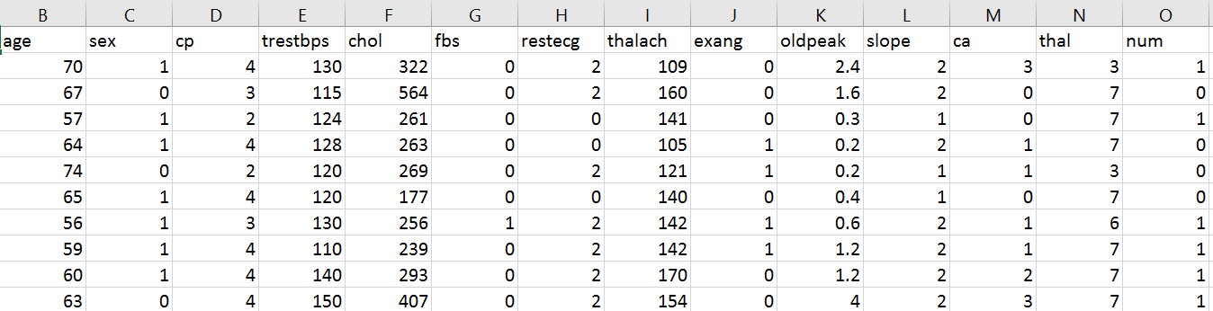
Statlog Heart Disease Dataset
Attributes → 14
Instances → 270
Prediction Variable → num
0: Absence | 1: Present
150 | 120

Slide 12
Statlog Heart Disease Dataset Preprocess
Labeled each column with the names provided
No Missing Values
Prediction Variable : num
Presence: 2 is assigned 1
Absence: 1 is assigned 0
We changed values to make our data consistent with other datasets

Slide 13
Statlog Hearth disease dataset results
Train Data
Algorithm | Accuracy | Misclassification Error | Sensitivity | Specificity
Logistic Regression | 86.84211 | 13.15789 | 83.52941 | 89.5238
Decision Trees | 76.84211 | 23.15789 | 56.4705 | 93.34
Neural Network | 55.26315789 | 44.73684211
Test Data
Algorithm | Accuracy | Misclassification Error | Sensitivity | Specificity
Logistic Regression | 82.5 | 17.5 | 68.5714 | 93.334
Decision Trees | 77.5 | 22.5 | 57.14285 | 93.34
Neural Network | 56.25 | 43.75

Slide 14
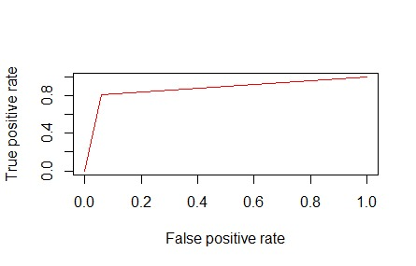
ROC – Logistic Regression
Train Data
Test Data

Slide 15
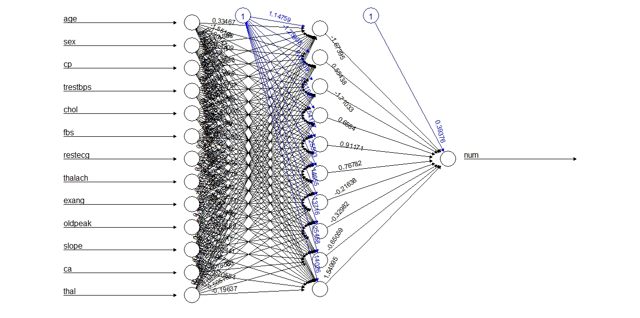
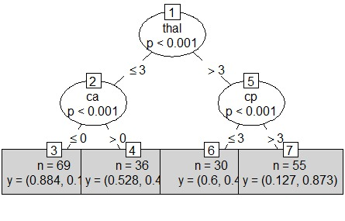
Decision Tree
Neural Network

Slide 16
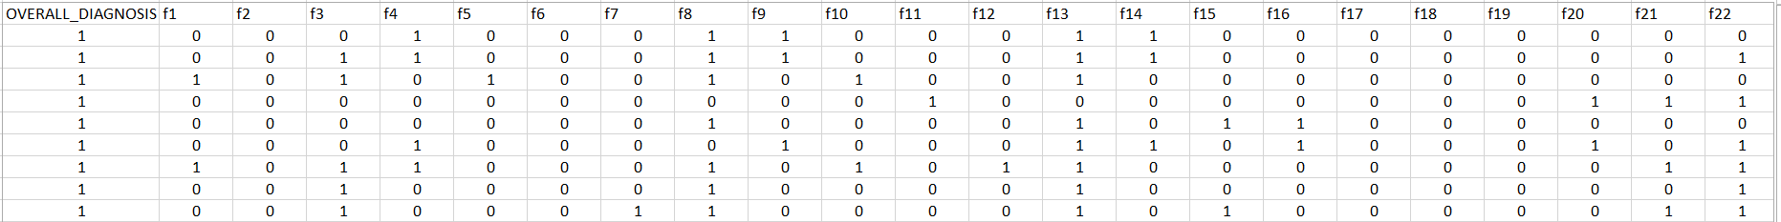
Spect Heart Disease Dataset
Features extracted from images
Attributes → 23
Dataset is divided into:
Training: 80
Testing: 187
Prediction Variable → OVERALL_DIAGNOSIS
Division | Test | Train
Present | 172 | 40
Absent | 15 | 40

Slide 17
Spect Heart Disease Dataset Results
Train Data
Algorithm | Accuracy | Misclassification Error | Sensitivity | Specificity
Logistic Regression | 83.75 | 16.25 | 80 | 8.75
Decision Trees | 78.75 | 21.25 | 77.5 | 80
Neural Network | 93.75 | 6.25 | 90 | 97.5
Test Data
Algorithm | Accuracy | Misclassification Error | Sensitivity | Specificity
Logistic Regression | 65.24064171 | 34.75935829 | 86.67 | 63.372
Decision Trees | 71.12299465 | 28.87700535 | 70.3488 | 80
Neural Network | 68.98395722 | 31.01604278 | 69.7674 | 60

Slide 18

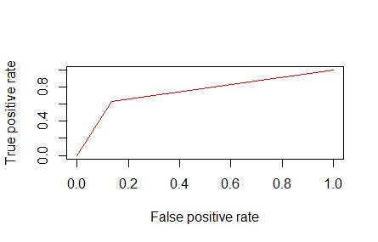
ROC – Logistic Regression
Train Data
Test Data

Slide 19
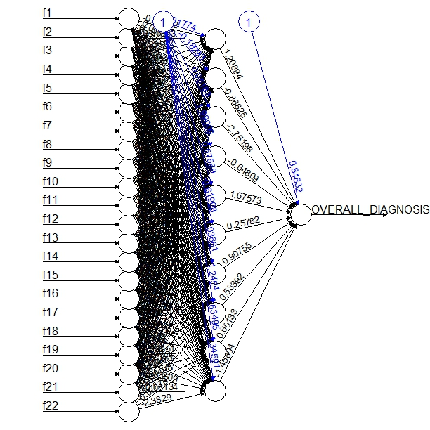
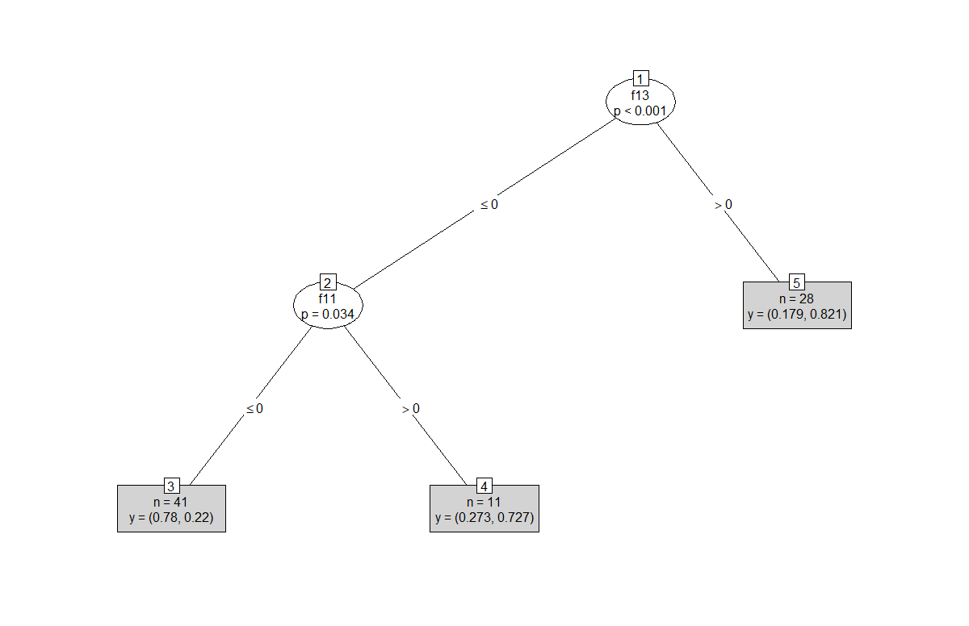
Decision Tree
Neural Network

Slide 20
Literature Review
Paper 1: Heart Disease Prediction using Machine Learning and Data Mining Technique
Cleveland Database Used
Compared 3 algorithms based on Decision Tree Classification:
J48 with Reduced-Error Pruning
Extension of the ID3 (Iterative Dichotomiser) model
One of the fastest pruning methods; produces accurate and small decision rules
Disadvantages: Large Space complexity and size of J48 trees
J48 rules slow for large and noisy datasets

Slide 21
Literature Review
Logistic Model Tree
Cost-complexity pruning
Uses cross validation for more stable results
Significantly Slower than other algorithms
Random Forest
Ensemble classifier, consisting of many decision trees
Improvisation over Bagging Algorithm
Combines with random selection of classifiers to construct decision trees with controlled variations

Slide 22
Literature Review
Comparison of the 3 Algorithms
J48: Higher Sensitivity & Accuracy
LMT: Higher Specificity than J48 and Random Forest
Conclusion for Best Overall Performance: J48 (More Accuracy & Least Total time to build)
 | Train Error | Test Error
J48 | 0.1423221 | 0.1666667
Logistic Model Tree | 0.1156716 | 0.237931
Random Forest | 0.0 | 0.2

Slide 23
Literature Review
Paper 2: Classification and Prediction of Heart Disease Risk Using Data Mining Techniques of Support Vector Machine and Artificial Neural Networks
Datasets used: Cleveland (MultiClass) and Statlog (Two-Class)
Analyze prediction variability of two class and multiclass problems
2 Algorithms used and compared
Support Vector Machine
Used to classify data, mainly used for two classes
Utilizes both linear & non-linear kernel functions

Slide 24
Literature Review
Performance Evaluation for SVM:
 | Accuracy | Precision | Sensitivity
SVM | 0.847 | 0.8506 | 0.8412

Slide 25
Literature Review
Artificial Neural Network
Dataset | Statlog | Cleveland
Training | 70% | 80%
Validation | 15% | 10%
Testing | 15% | 10%

Slide 26
Literature Review
Analysis showed SVM is more viable than ANN
ANN has advantage of performing better in terms of Specificity & Adaptability to extensive training
For Statlog Dataset:
Specificity: ANN outperformed SVM
 | Precision Comparison | Accuracy | Sensitivity
SVM | 85.6% | 84.7% | 84.12%
ANN | 83.3% | 81.8% | 68.7%

Slide 27
Future Work
K-fold Cross Validation
Transfer Learning
TCA
TrAdaBoost
GFK
Overfitting / Underfitting

Slide 28
References
Heart Disease Prediction Using Machine learning and Data Mining Technique: http://csjournals.com/IJCSC/PDF7-1/18.%20Tejpal.pdf
Intelligent and Effective Heart Disease Prediction System using Weighted Associative Classifiers: http://citeseerx.ist.psu.edu/viewdoc/download?doi=10.1.1.302.6636&rep=rep1&type=pdf
Classification and prediction of heart disease risk using data mining techniques of Support Vector Machine and Artificial Neural Network: http://ieeexplore.ieee.org/document/7724835/
Diagnosis of heart disease patients using fuzzy classification technique: http://ieeexplore.ieee.org/document/7066746/
Knowledge discovery approach to automated cardiac SPECT diagnosis: http://citeseerx.ist.psu.edu/viewdoc/download?doi=10.1.1.17.3773&rep=rep1&type=pdf

Slide 29
References
Lecture Slides
https://www.medcalc.org/manual/logistic_regression.php
https://en.wikipedia.org/wiki/Logistic_regression#/media/File:Linear_regression.svg
https://www.doc.ic.ac.uk/~nd/surprise_96/journal/vol4/cs11/report.html

Slide 30
Thank you ☺

